Slide 1
Bigdata Project
Prof. Premchand Nair
Student: Minh Hieu Nguyen
ID: 985949

Slide 2
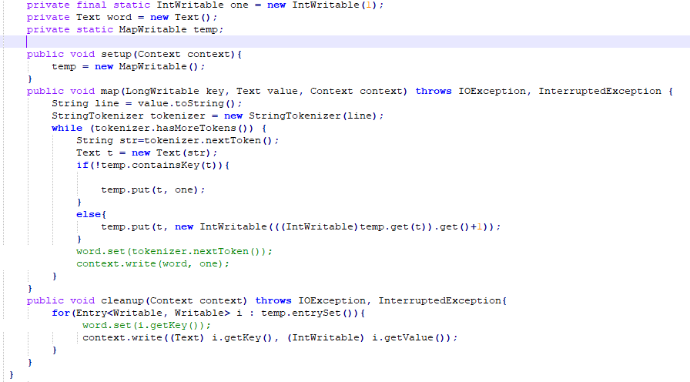
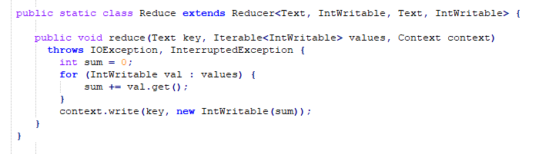
InMapperWordCount

Slide 3
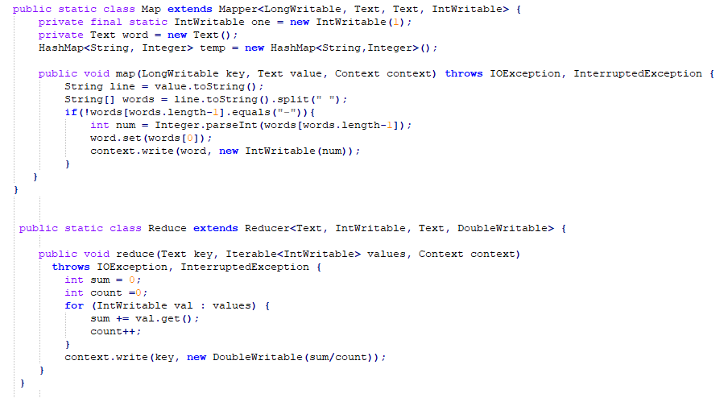
Average computation

Slide 4
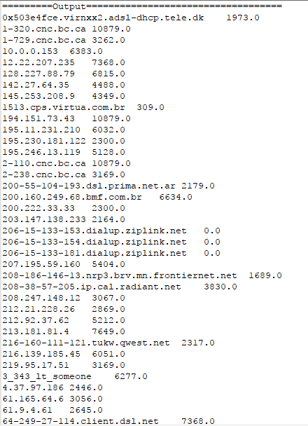
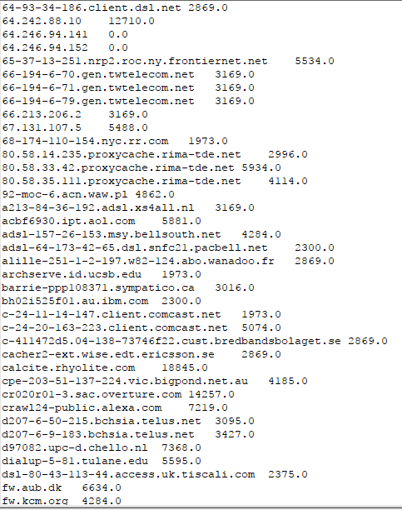
Average computation - Output

Slide 5
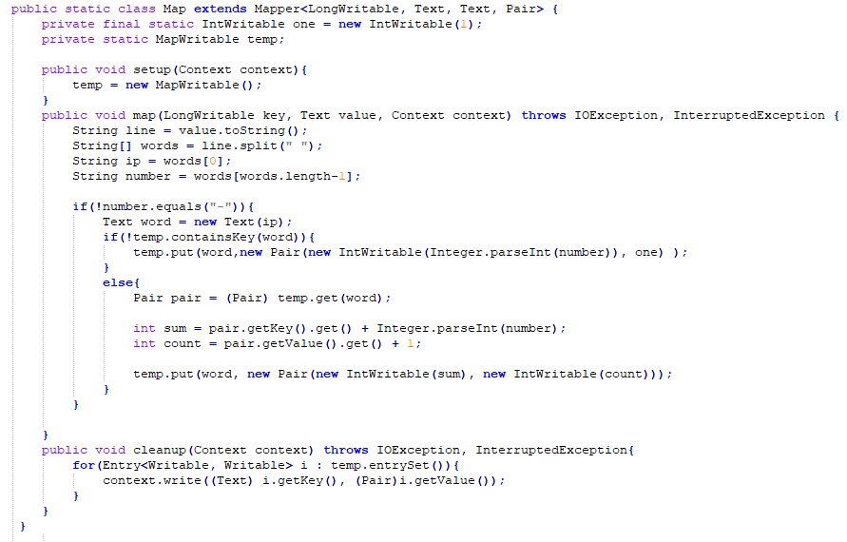
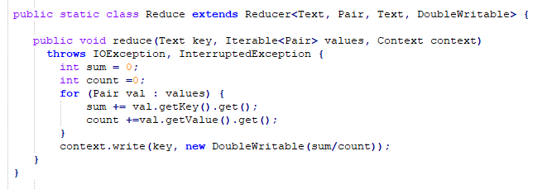
InMapper Average

Slide 6
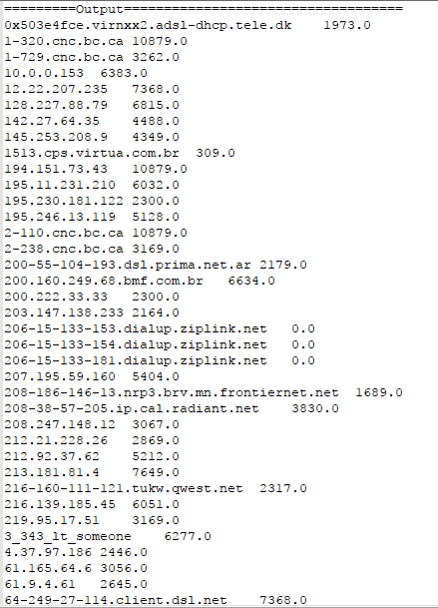
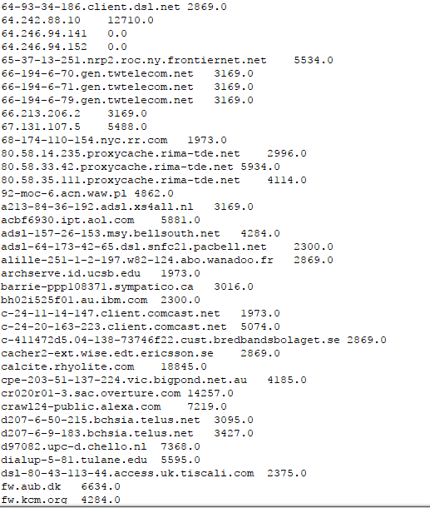
InMapper Average - Output

Slide 7
Pseudo code for PAIR approach
Class mapper
Method map(docid a, doc d)
for all term w in doc d
for all term u in neighborhood(w)
emit(pair(w,*), 1)
emit(pair(w,u), 1)
Class Reducer
Sum <- 0
Method reduce(pair p, counts[c1,…])
count <- 0
tmp <- pair[1]
if(tmp == “*”)
sum<- 0
for all count c in counts[c1,…]
sum <- sum + c
else
for all count c in counts[c1,…]
count <- count + c
if(tmp== “*”) emit(pair p, sum)
else emit(pair p, count/sum)

Slide 8
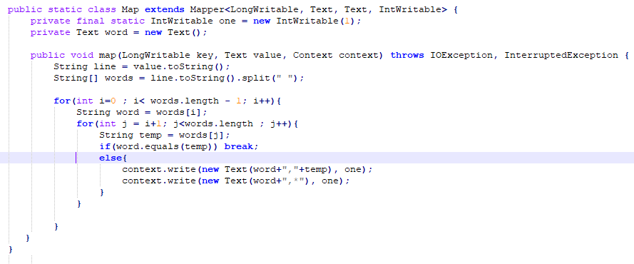
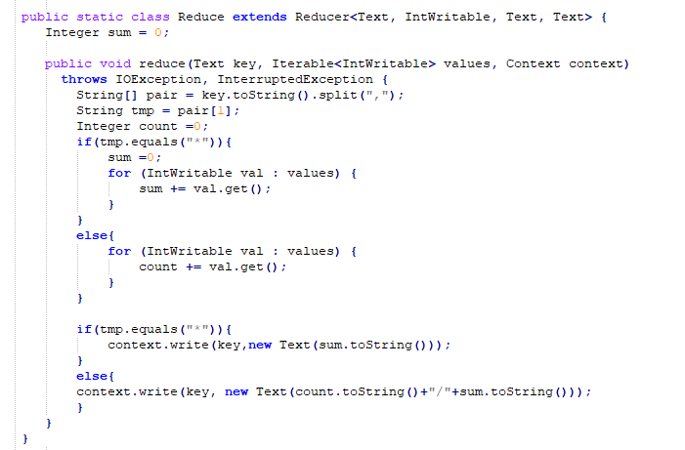
Java code for PAIR approach

Slide 9
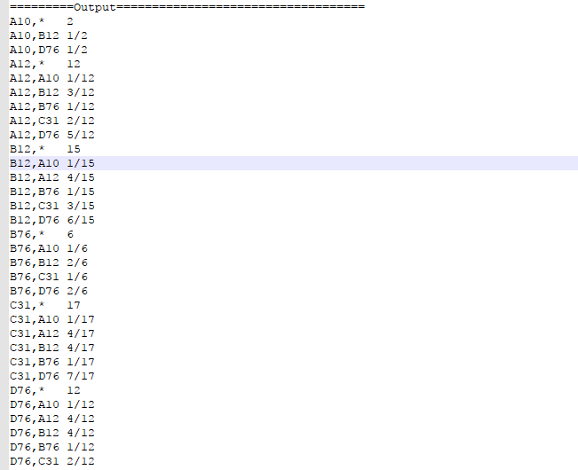
Result of PAIR approach

Slide 10
Pseudo code for STRIPE approach
Class mapper
Method map(docid a, doc d)
for all term w in doc d
H <- new associateArray
for all term u in neighborhood(w)
if(H{u}.isNull) H{u} <- 1
else H{u} <- H{u} + 1
Emit(term w, stripe H)
Class Reducer
Method reduce(term w, stripes[H1,…])
Hf <- new associateArray
for all stripe H in stripes[H1,…]
sum(Hf,H)
emit(term w, stripe Hf)

Slide 11
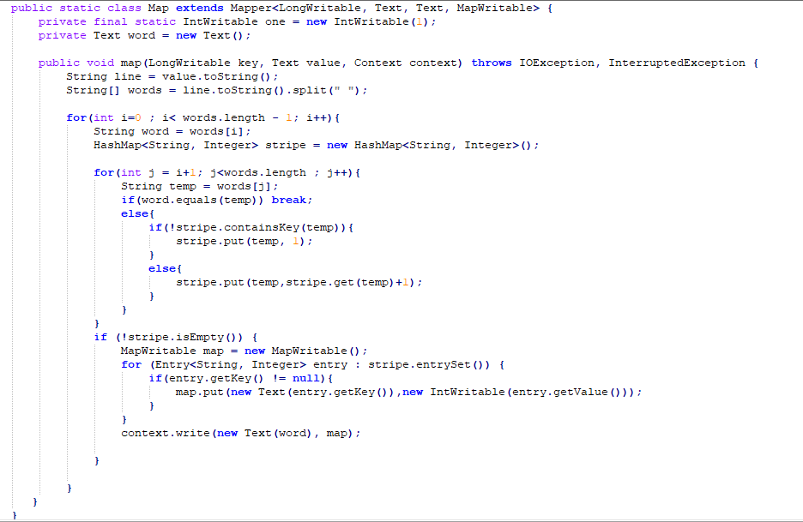
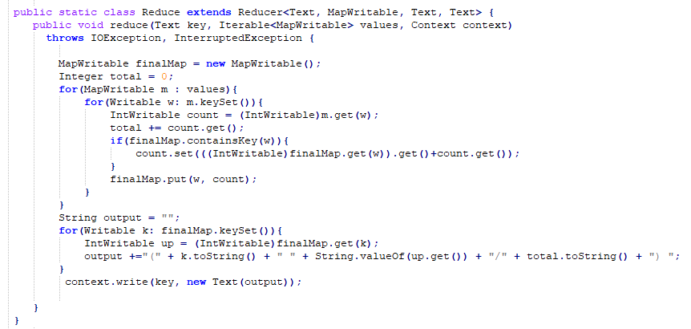
Java code for STRIPE approach

Slide 12
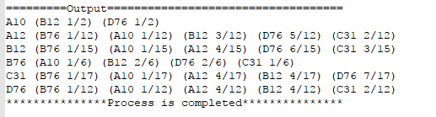
Result of STRIPE approach

Slide 13
Pseudo code for HYBRID approach
Class mapper
Method map(docid a, doc d)
for all term w in doc d
for all term u in neighborhood(w)
emit(pair(w,u), 1)
Class Reducer
Hf <- new associateArray
Sum <- 0
Key <- “”
Method reduce(pair p, counts[c1,…])
tmp <- pair[0]
if(tmp != key) emit(term key, stripe Hf/sum)
count <- 0
for all count c in counts[c1,,…]
count <- count + c
Hf.put(pair[1],count)
sum <- sum + count
key <- tmp
Method close
emit(term key, stripe Hf/sum)

Slide 14
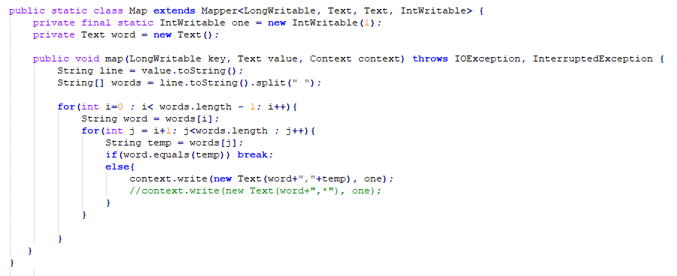
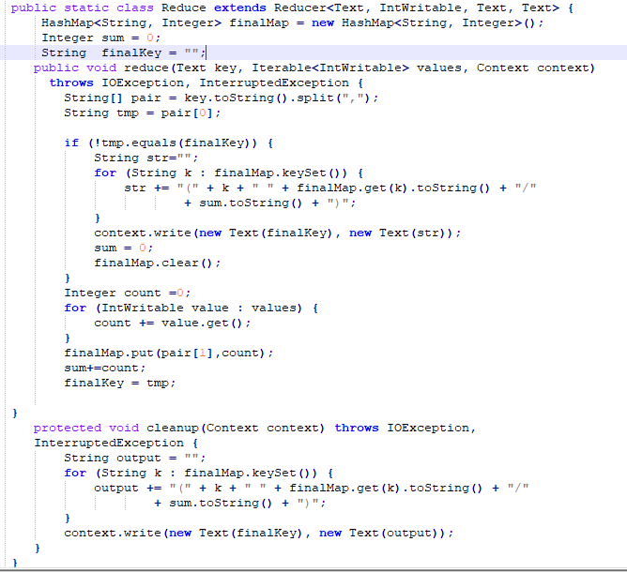
Java code for HYBRID approach

Slide 15
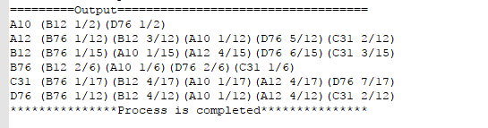
Result of HYBRID approach

Slide 16
Time and resource comparison : Pair-Stripe-Hybrid
Pair | Stripe | Hybrid
Execution Time : 71.813 | Execution Time : 47.124 | Execution Time : 44.582
Map-Reduce Framework Map input records=2 Map output records=128 Map output bytes=1408 Map output materialized Reduce input groups=32 Reduce shuffle bytes=1670 Reduce input records=128 Reduce output records=32 Spilled Records=256 Shuffled Maps =1 Failed Shuffles=0 Merged Map outputs=1 GC time elapsed (ms)=214 CPU time spent (ms)=2240 Physical memory (bytes) snapshot=344412160 Virtual memory (bytes) snapshot=3016187904 Total committed heap usage (bytes)=226627584 | Map-Reduce Framework Map input records=2 Map output records=20 Map output bytes=720 Map output materialized Reduce input groups=6 Reduce shuffle bytes=766 Reduce input records=20 Reduce output records=6 Spilled Records=40 Shuffled Maps =1 Failed Shuffles=0 Merged Map outputs=1 GC time elapsed (ms)=209 CPU time spent (ms)=1830 Physical memory (bytes) snapshot=361844736 Virtual memory (bytes) snapshot=3015716864 Total committed heap usage (bytes)=226627584 | Map-Reduce Framework Map input records=2 Map output records=64 Map output bytes=768 Map output materialized Reduce input groups=26 Reduce shuffle bytes=902 Reduce input records=64 Reduce output records=6 Spilled Records=128 Shuffled Maps =1 Failed Shuffles=0 Merged Map outputs=1 GC time elapsed (ms)=203 CPU time spent (ms)=1750 Physical memory (bytes) snapshot=356331520 Virtual memory (bytes) snapshot=3015274496 Total committed heap usage (bytes)=226627584

Slide 17
MAP REDUCE
DEMO

Slide 18
Problem statement
Analyze access long to compute some problem
Compute response frequencies
Determine IP address access more than a specific number
Determine content request
Determine content request (sorted)
Compute average content size

Slide 19
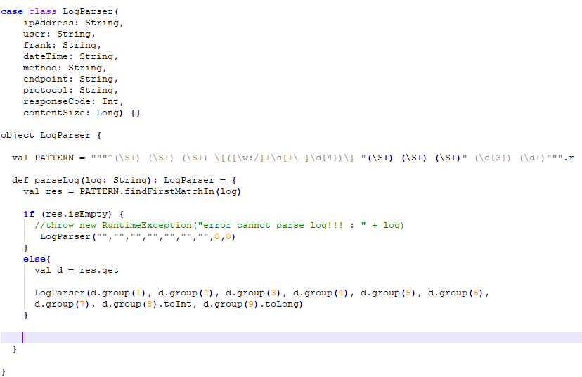
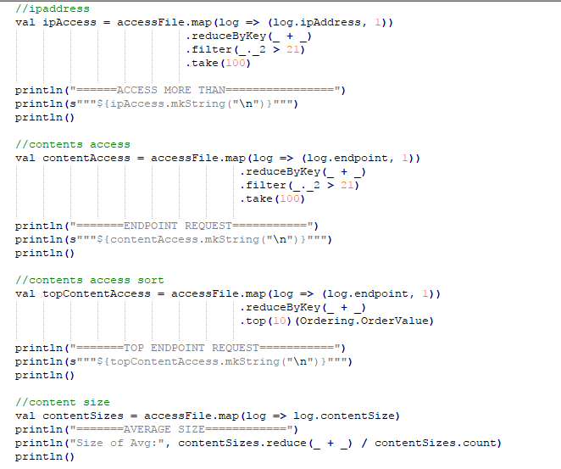
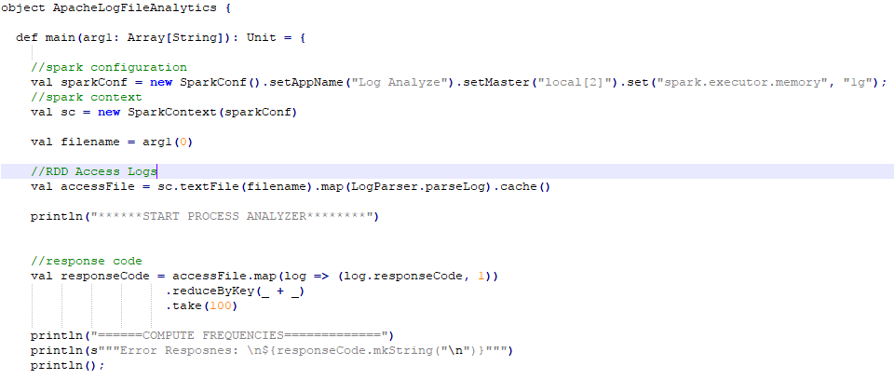
Scala code

Slide 20
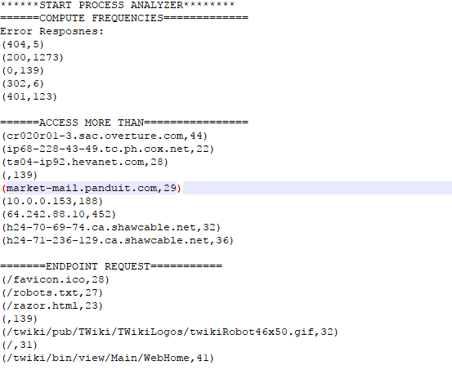
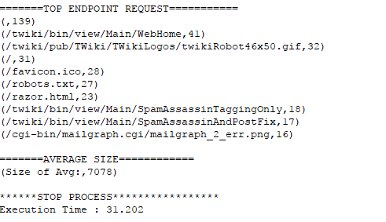
Spark- output

Slide 21
Spark
DEMO

